Slide 1
Relational Algebra
&
Relational Calculus

Slide 2
Objectives
Meaning of the term relational completeness.
How to form queries in relational algebra.
How to form queries in tuple relational calculus.
How to form queries in domain relational calculus.
Categories of relational DML.

Slide 3
Introduction
Relational algebra and relational calculus are formal languages associated with the relational model.
Informally, relational algebra is a (high-level) procedural language and relational calculus a non-procedural language.
However, formally both are equivalent to one another.
A language that produces a relation that can be derived using relational calculus is relationally complete.

Slide 4
Database Query Languages
Given a database, ask questions, get data as answers
  Get all students with GPA > 3.7 who applied to USQ and QUT and nowhere else
  Get all humanities departments at campuses in Queensland with < 200 applicants
  Get the campus with highest average accept rate over the last five years
Some questions are easy to pose, some are not
Some questions are easy for DBMS to answer, some are not.
"Query language“, but also used to update the database

Slide 5
Relational Query Languages
Formal:
  relational algebra, relational calculus, Datalog
Practical:
  SQL,
  Quel,
  Query-by-Example (QBE)
In ALL languages, a query is executed over a set of relations, get single relation as the result

Slide 6
Relational Algebra (RA)
Relational algebra operations work on one or more relations to define another relation without changing the original relations.
Both operands and results are relations, so output from one operation can become input to another operation.
Allows expressions to be nested, just as in arithmetic. This property is called closure.

Slide 7
Relational Algebra
5 basic operations in relational algebra: Selection, Projection, Cartesian product, Union, and Set Difference.
These perform most of the data retrieval operations needed.
Also have Join, Intersection, and Division operations, which can be expressed in terms of 5 basic operations.

Slide 8
RA Operations
Operations of traditional relational algebra fall into four broad classes:
  Operations that remove parts of a relation
  Renaming
  Set operations
  Operations that combine tuples of two relations

Slide 9

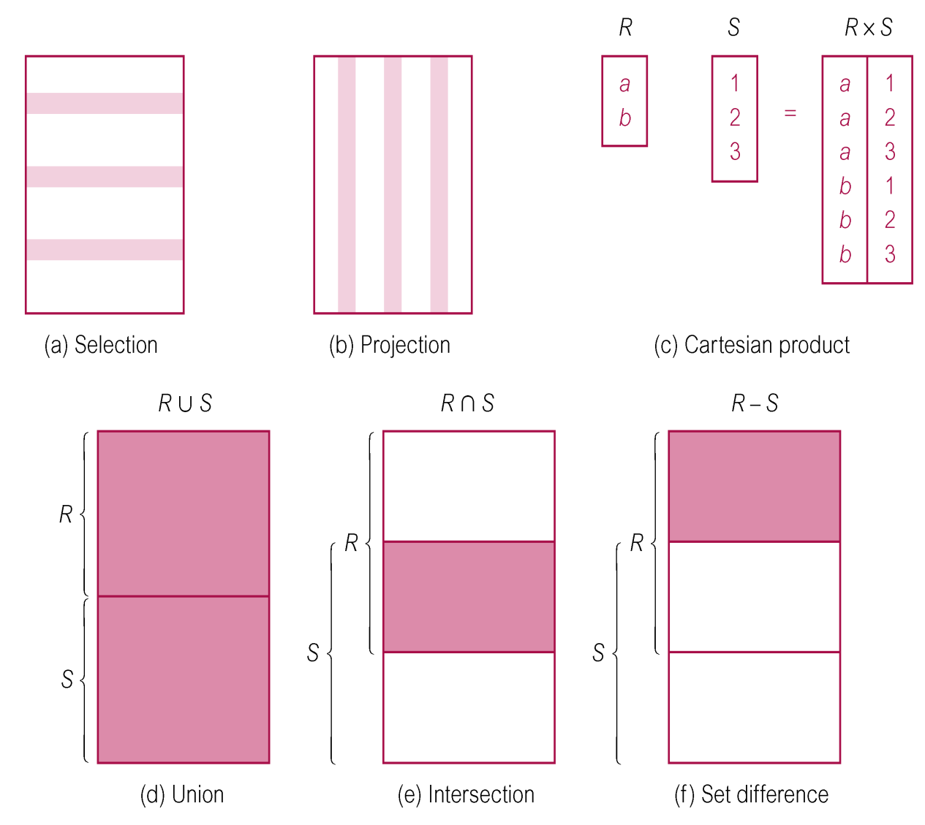
Relational Algebra Operations

Slide 10
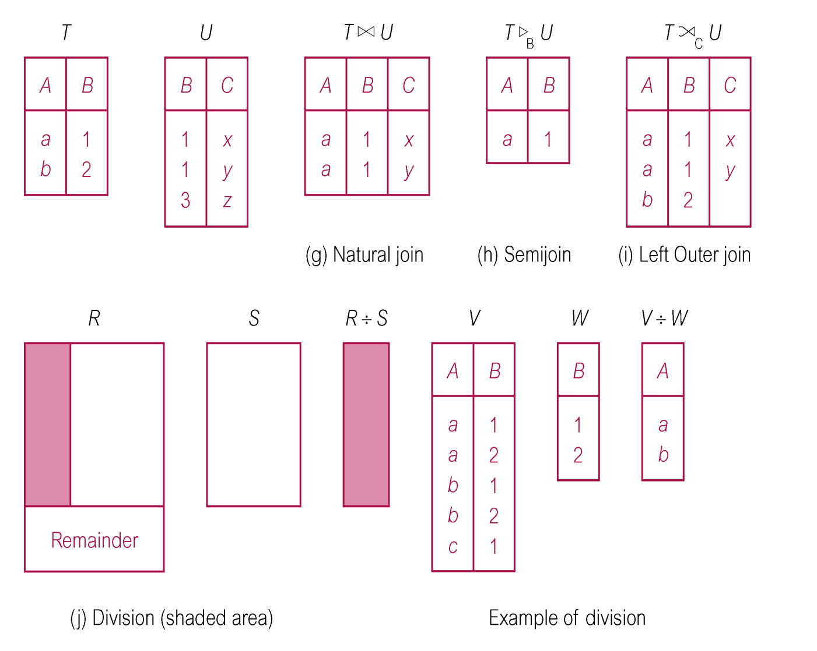
Relational Algebra Operations

Slide 11
Selection (or Restriction)
σ_{predicate} (R)
  Works on a single relation R (unary operation) and defines a relation that contains only those tuples (rows) of R that satisfy the specified condition (predicate).
  Schema of σ_{C} (R) is the same as schema of R
  Selection loses information
  Condition C:
    AND, OR, NOT, A θ B, A θ c, where θ {<, ≤, >, ≥, =, ≠}

Slide 12
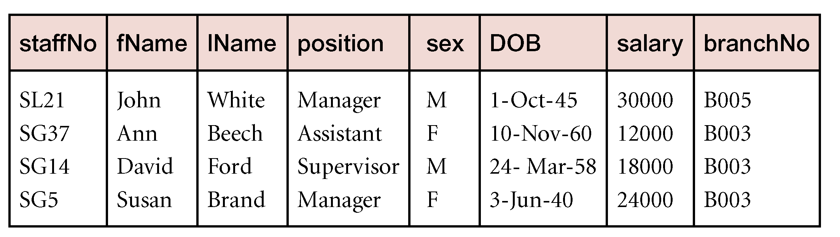
Example - Selection (or Restriction)
List all staff with a salary greater than £10,000.
  σ_{salary > 10000} (Staff)

Slide 13
Projection
Π_{col1, . . . , coln}(R)
  Works on a single relation R (unary operation) and defines a relation that contains a vertical subset of R, extracting the values of specified attributes and eliminating duplicates.
  Projection loses information
    Possibly vertically, possibly horizontally
  Schema of resulting relation: attributes subset of the attributes of R

Slide 14
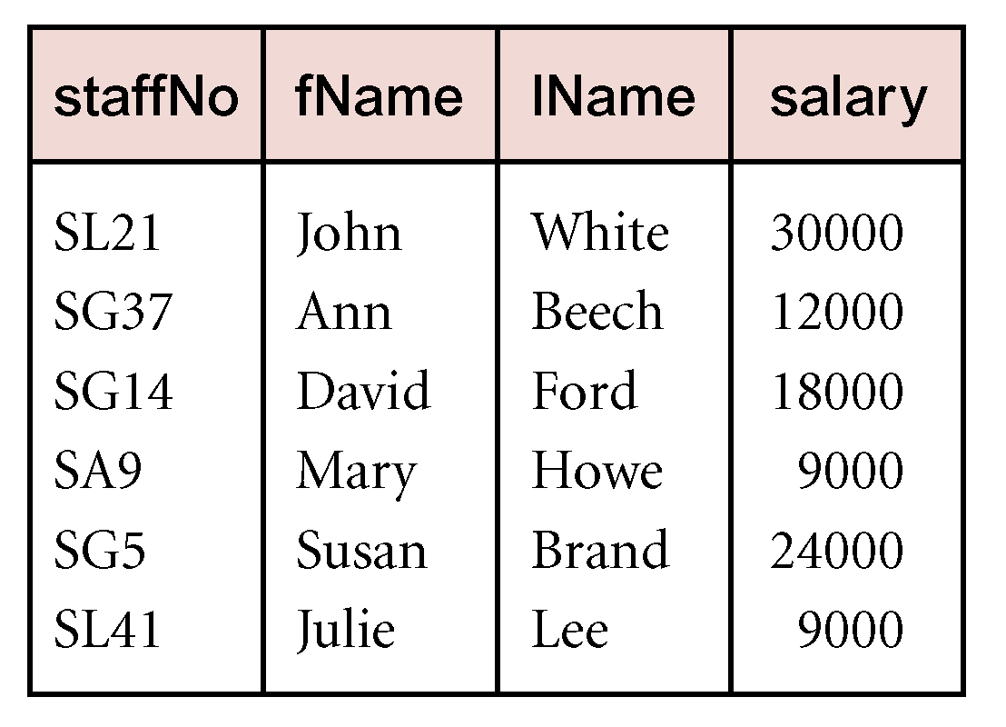
Example - Projection
Produce a list of salaries for all staff, showing only staffNo, fName, lName, and salary details.
  Π_{staffNo, fName, lName, salary}(Staff)

Slide 15
Rename
ρ_{γ} (R) (unary operation)
  γ is a one-to-one function that maps a set of attributes to a new set of attributes
  Schema is the same, up to renaming of attributes
  Content, or instance, remains unchanged

Slide 16
Union
R ∪ S (binary operation, set operation)
  Union of two relations R and S defines a relation that contains all the tuples of R, or S, or both R and S, duplicate tuples being eliminated.
  R and S must be union-compatible.
    Same set of attributes + domains
If R and S have I and J tuples, respectively, union is obtained by concatenating them into one relation with a maximum of (I + J) tuples.
Lossless, but impossible to undo
commutative, associative

Slide 17
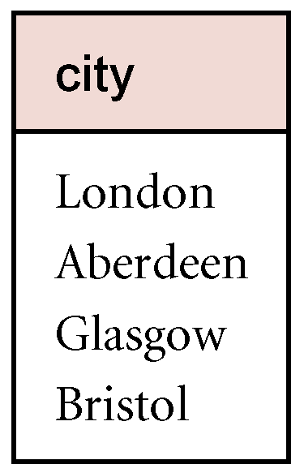
Example - Union
List all cities where there is either a branch office or a property for rent.
  Π_{city}(Branch) ∪ Π_{city}(PropertyForRent)

Slide 18
Set Difference
R – S (binary operation, set operation)
  Defines a relation consisting of the tuples that are in relation R, but not in S.
  R and S must be union-compatible.
  Loses information
  R - S ≠ S - R !!

Slide 19
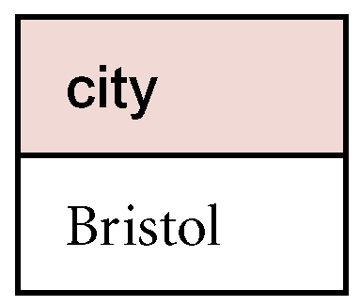
Example - Set Difference
List all cities where there is a branch office but no properties for rent.
  Π_{city}(Branch) – Π_{city}(PropertyForRent)

Slide 20
Intersection
R ∩ S (binary operation, set operation)
  Defines a relation consisting of the set of all tuples that are in both R and S.
  R and S must be union-compatible.
Expressed using basic operations:
  R ∩ S = R – (R – S)
commutative, associative

Slide 21
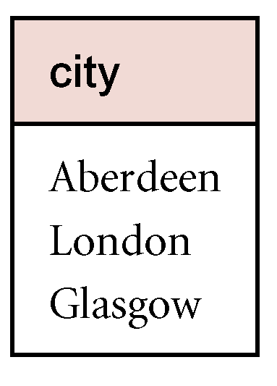
Example - Intersection
List all cities where there is both a branch office and at least one property for rent.
  Π_{city}(Branch) ∩ Π_{city}(PropertyForRent)

Slide 22
Cartesian product
R × S (binary operation, set operation)
  Defines a relation that is the concatenation of every tuple of relation R with every tuple of relation S.
  Lossless, possible to undo using projection
    Unless one of R, S is empty!
  #(R x S) = #R * #S
  Schema: union of sets of attributes
  commutative, associative

Slide 23
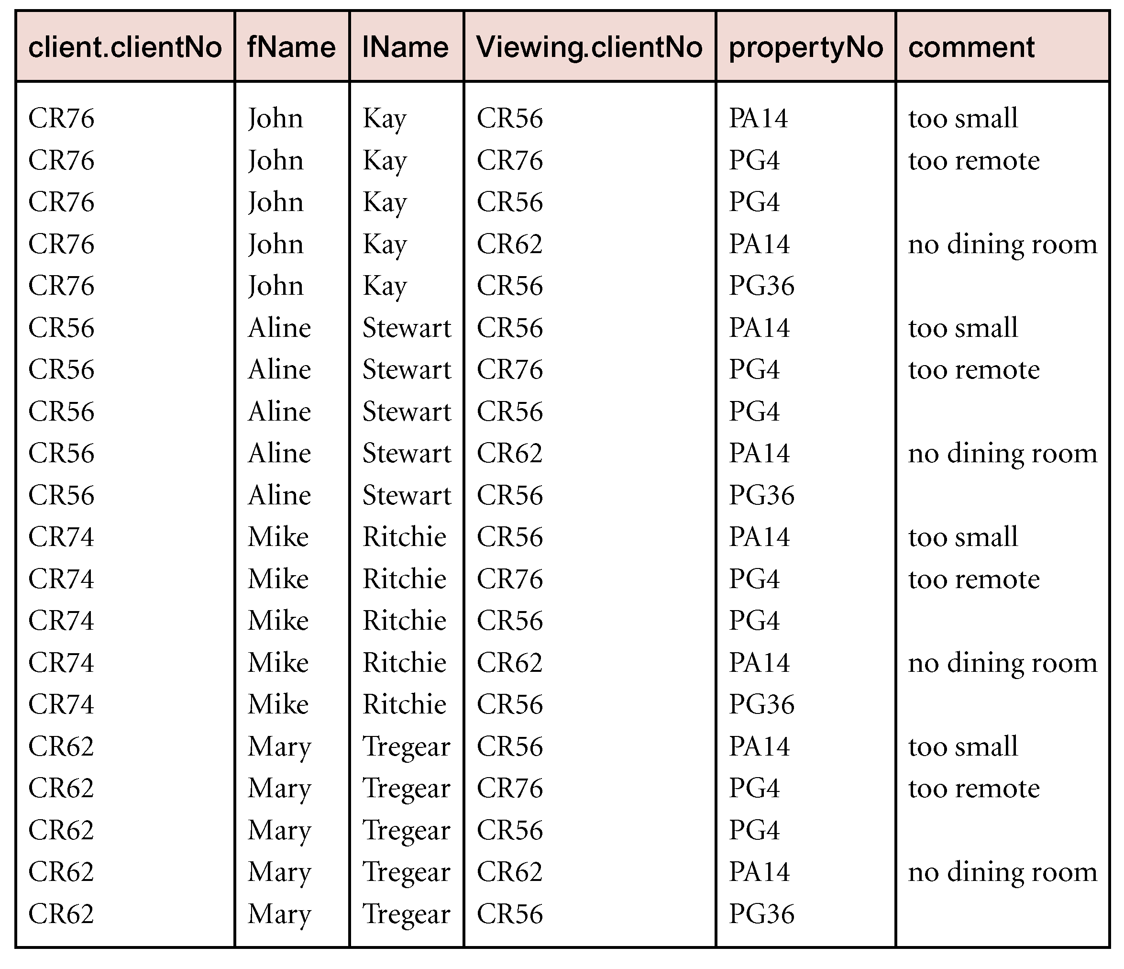
Example - Cartesian Product
List the names and comments of all clients who have viewed a property for rent.
  (Π_{clientNo, fName, lName}(Client)) X (Π_{clientNo, propertyNo,comment} (Viewing))
  Requires
  further
  restriction!

Slide 24
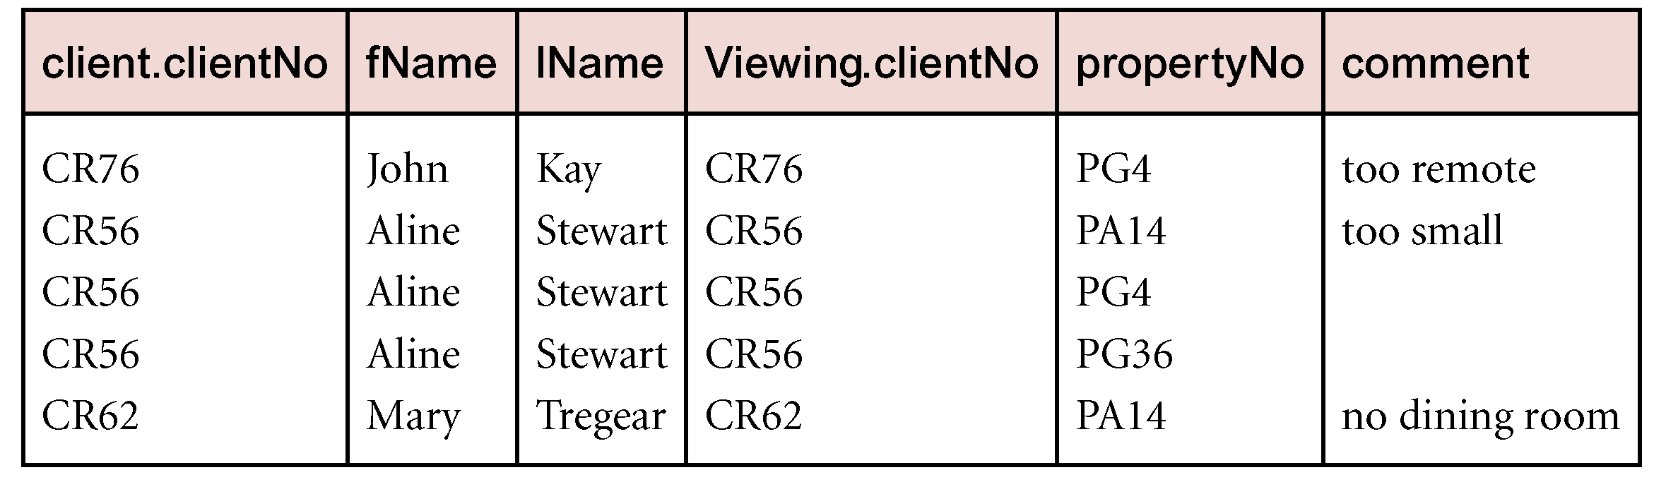
Example - Cartesian Product and Selection
Use selection operation to extract those tuples where Client.clientNo = Viewing.clientNo.
  σClient.clientNo = viewing.clientNo((∏_{clientNo,fName,lName}(Client)) Χ (∏_{clientNo,propertyNo,comment}(Viewing)))
Cartesian product and Selection can be reduced to a single operation called a Join.

Slide 25
Join Operations
Join is a derivative of Cartesian product.
Equivalent to performing a Selection, using join predicate as selection formula, over Cartesian product of the two operand relations.
  σ_{C} (R × S)
One of the most difficult operations to implement efficiently in an RDBMS and one reason why RDBMSs have intrinsic performance problems.
  But can usually be optimized

Slide 26
Join Operations
Various forms of join operation
  Theta join
  Equijoin (a particular type of Theta join)
  Natural join
  Outer join
  Semijoin

Slide 27
Theta join (θ-join)
R _{F} S
  Defines a relation that contains tuples satisfying the predicate F from the Cartesian product of R and S.
  The predicate F is of the form R.a_{i} θ S.b_{i} where θ may be one of the comparison operators (<, ≤, >, ≥, =, ≠).

Slide 28
Theta join (θ-join)
Can rewrite Theta join using basic Selection and Cartesian product operations.
    R _{F}S = σ_{F}(R × S)
Degree of a Theta join is sum of degrees of the operand relations R and S.
If predicate F contains only equality (=), the term Equijoin is used.

Slide 29
Example - Equijoin
List the names and comments of all clients who have viewed a property for rent.
  (Π_{clientNo,fName,lName}(Client)) Client.clientNo = Viewing.clientNo (Π_{clientNo,propertyNo,comment}(Viewing))

Slide 30
Natural Join
R S
  An Equijoin of the two relations R and S over all common attributes x. One occurrence of each common attribute is eliminated from the result.
  Usual simulation (selection and cartesian product), plus projection

Slide 31
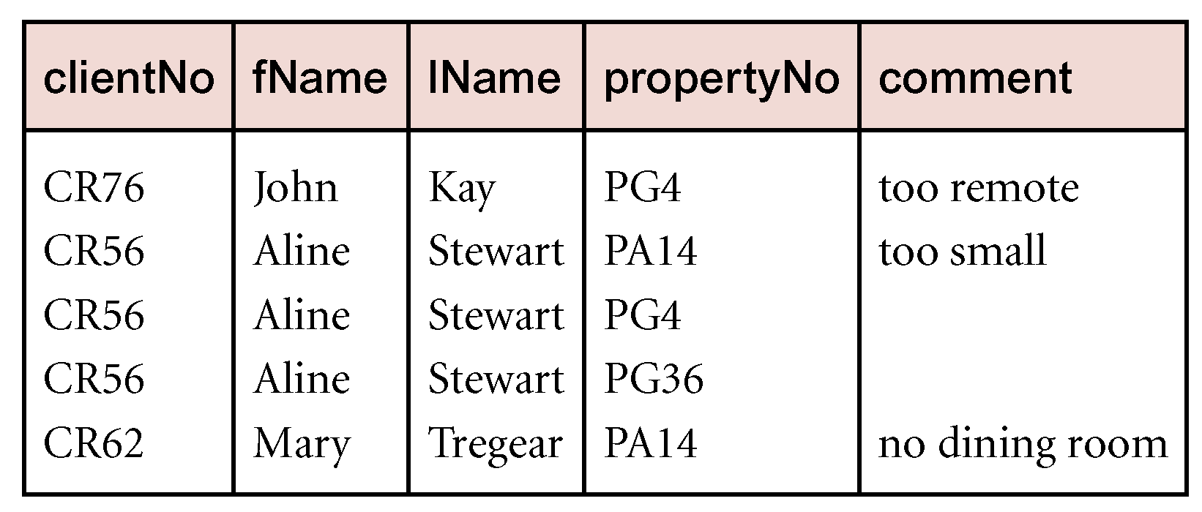
Example - Natural Join
List the names and comments of all clients who have viewed a property for rent.
  (Π_{clientNo,fName,lName}(Client)) (Π_{clientNo,propertyNo,comment}(Viewing))

Slide 32
Outer join
To display rows in the result that do not have matching values in the join column, use Outer join.
R S
  (Left) outer join is join in which tuples from R that do not have matching values in common columns of S are also included in result relation.
  Padded with NULLs

Slide 33
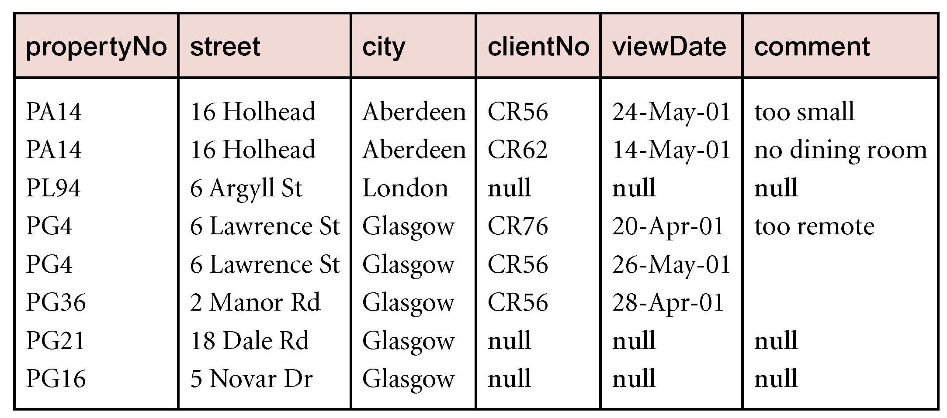
Example - Left Outer join
Produce a status report on property viewings.
  Π_{propertyNo,street,city}(PropertyForRent) Viewing

Slide 34
Semijoin
R _{F}S
  Defines a relation that contains the tuples of R that participate in the join of R with S.
Can rewrite Semijoin using Projection and Join:
  R _{F}S = Π_{A}(R _{F} S)

Slide 35
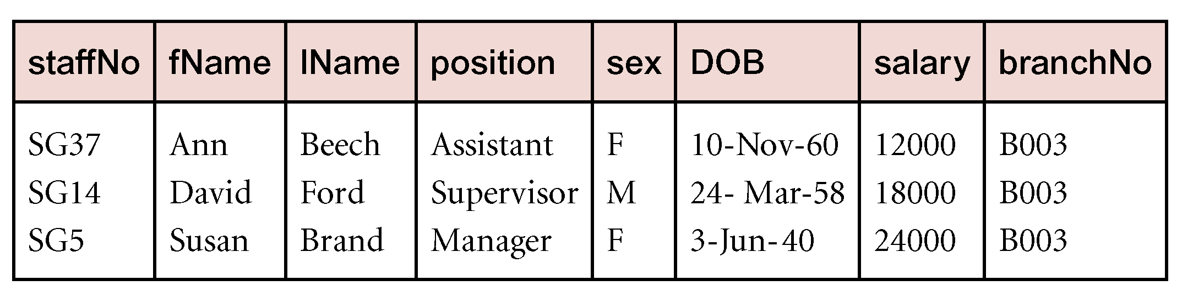
Example - Semijoin
List complete details of all staff who work at the branch in Glasgow.
  Staff Staff.brancNo = Branch.branchNo and branch.city = ‘Glasgow’ Branch

Slide 36
Division
R ÷ S
  Defines a relation over the attributes C that consists of set of tuples from R that match combination of every tuple in S.
Expressed using basic operations:
  T₁ ← Π_{C} (R)
  T₂ ← Π_{C} ((S × T₁) – R)
  T ← T₁ – T₂

Slide 37
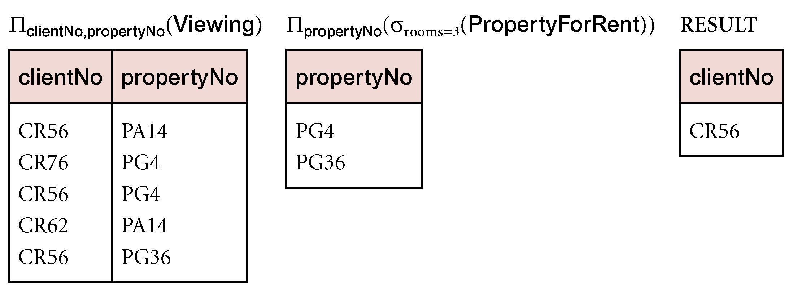
Example - Division
Identify all clients who have viewed all properties with three rooms.
  (Π_{clientNo,propertyNo}(Viewing)) ÷ (Π_{propertyNo}(σ_{rooms = 3} (PropertyForRent)))

Slide 38
Why Relational Algebra?
All DBMSs use relational algebra as intermediate language for specifying query evaluation algorithms
  Parse SQL and translate it into expression in relational algebra
  However, translated expression (or straight SQL) would be very inefficient
Set of rules for manipulating algebraic expressions
  Don’t exist for SQL
  Expressions can be converted into equivalent ones which take less time to execute
  Done by query optimizer

Slide 39

Overview of Query Processing
SQL Query
Parser
Relational Algebra Expression
Query Optimizer
Query Execution Plan
Code Generator
Executable Code

Slide 40
Remarks about the Relational Algebra
The Relational Algebra is not Turing Complete
  No explicit loop
  No recursion
This is a feature, not a bug
  Helps with query optimization and processing
  Operations are linear in size of instance
It is undecidable whether two algebra expressions are equivalent
  Restriction to Conjunctive Queries: decidable
    CQ: Selection, projection, Cartesian product only
No transitive closure!

Slide 41
Non-trivial example queries
Consider the relation schema:
  Visits(Drinker,Bar); Likes(Drinker,Beer); Serves(Bar,Beer);
Give all the drinkers with the beers they do not like
  (Π_{Drinker}(Likes) x Π_{Beer}(Likes)) - Likes
Give the pairs of beers that are not served in a common bar
  (Π_{Beer}(Serves) x Π_{Beer}(Serves)) -
  Π_{Beer1,Beer2}.σ_{Bar1=Bar2}(Serves x Serves)

Slide 42
More hard RA expressions
Give all the drinkers that like all beers that ‘John’ likes
  Likes : Π_{Beer} . σ_{Drinker=‘John’} (Likes)
Give all the drinkers that like exactly the same beers as ‘John’
  ( Likes : Π_{Beer} . σ_{Drinker=‘John’} (Likes) ) ∩
  (((Π_{Drinker}(Likes) X Π_{Beer}(Likes)) - Likes) :
  Π_{Beer}. σ_{Drinker=‘John’} ((Π_{Drinker}(Likes) X Π_{Beer}(Likes)) - Likes))

Slide 43
Relational Calculus (RC)
Relational calculus query specifies what is to be retrieved rather than how to retrieve it.
  No description of how to evaluate a query.
In first-order logic (or predicate calculus), predicate is a truth-valued function with arguments.
When we substitute values for the arguments, function yields an expression, called a proposition, which can be either true or false.

Slide 44
Relational Calculus
If predicate contains a variable (e.g. ‘x is a member of staff’), there must be a range for x.
When we substitute some values of this range for x, proposition may be true; for other values, it may be false.
When applied to databases, relational calculus has two forms: tuple and domain.

Slide 45
Tuple Relational Calculus (TRC)
Interested in finding tuples for which a predicate is true. Based on use of tuple variables.
Tuple variable is a variable that ‘ranges over’ a named relation: i.e., variable whose only permitted values are tuples of the relation.
Specify range of a tuple variable S as the Staff relation as:
  Staff(S)
To find set of all tuples S such that P(S) is true:
  {S | P(S)}

Slide 46
Tuple Relational Calculus - Example
To find details of all staff earning more than £10,000:
  {S | Staff(S) ∧ S.salary > 10000}
To find a particular attribute, such as salary, write:
  {S.salary | Staff(S) ∧ S.salary > 10000}

Slide 47
Tuple Relational Calculus
Can use two quantifiers to tell how many instances the predicate applies to:
  Existential quantifier ∃ (‘there exists’)
  Universal quantifier ∀ (‘for all’)
Tuple variables qualified by ∀ or ∃ are called bound variables, otherwise called free variables.

Slide 48
Tuple Relational Calculus
Existential quantifier used in formulae that must be true for at least one instance, such as:
  Staff(S) ∧ (∃B)(Branch(B) ∧ (B.branchNo = S.branchNo) ∧ B.city = ‘London’)
Means ‘There exists a Branch tuple that has the same branchNo as the branchNo of the current Staff tuple, S, and is located in London’.

Slide 49
Tuple Relational Calculus
Universal quantifier is used in statements about every instance, such as:
  (∀B) (B.city ≠ ‘Paris’)
Means ‘For all Branch tuples, the address is not in Paris’.
Can also use ~(∃B) (B.city = ‘Paris’) which means ‘There are no branches with an address in Paris’.

Slide 50
Tuple Relational Calculus
Formulae should be unambiguous and make sense.
A (well-formed) formula is made out of atoms:
    R(S_{i}), where S_{i} is a tuple variable and R is a relation
    S_{i}.a₁ θ S_{j}.a₂
    S_{i}.a₁ θ c
Can recursively build up formulae from atoms:
    An atom is a formula
    If F₁ and F₂ are formulae, so are their conjunction, F₁ ∧ F₂; disjunction, F₁ ∨ F₂; and negation, ~F₁
    If F is a formula with free variable X, then (∃X)(F) and (∀X)(F) are also formulae.

Slide 51
Example - Tuple Relational Calculus
List the names of all managers who earn more than £25,000.
  {S.fName, S.lName | Staff(S) ∧
  S.position = ‘Manager’ ∧ S.salary > 25000}
List the staff who manage properties for rent in Glasgow.
  {S | Staff(S) ∧ (∃P) (PropertyForRent(P) ∧ (P.staffNo = S.staffNo) ∧ P.city = ‘Glasgow’)}

Slide 52
Example - Tuple Relational Calculus
List the names of staff who currently do not manage any properties.
  {S.fName, S.lName | Staff(S) ∧ (~(∃P) (PropertyForRent(P)∧(S.staffNo = P.staffNo)))}
Or
  {S.fName, S.lName | Staff(S) ∧ (∀P) (~PropertyForRent(P) ∨
  ~(S.staffNo = P.staffNo)))}

Slide 53
Example - Tuple Relational Calculus
List the names of clients who have viewed a property for rent in Glasgow.
  {C.fName, C.lName | Client(C) ∧ ((∃V)(∃P)
  (Viewing(V) ∧ PropertyForRent(P) ∧ (
  C.clientNo = V.clientNo) ∧
  (V.propertyNo=P.propertyNo)∧P.city =‘Glasgow’))}

Slide 54
Tuple Relational Calculus
Expressions can generate an infinite set. For example:
  {S | ~Staff(S)}
To avoid this [an unsafe query], add restriction that all values in result must be values in the domain of the expression.
  Basically, tie all tuple variables to a relation

Slide 55
Unsafe queries in TRC
The following TRC expressions are safe
  { t(A) | ∃u (R(u) AND u(A) = t(A)) }
  { t(A) | NOT ∃u (R(u) AND u(A) ≠ t(A)) }
  { t(A) | ∀u (R(u) => u(A) = t(A)) }
The following TRC expressions are unsafe
  { t(A,B) | NOT R(t) }
  { t(A) | ∃u(u(A) = t(A)) }
  { t(A) | ∀u(R(u) AND t(A) = 8) }

Slide 56
Domain Relational Calculus (DRC)
Uses variables that take values from domains instead of tuples of relations.
If F(d₁, d₂, . . . , d_{n}) stands for a formula composed of atoms and d₁, d₂, . . . , d_{n} represent domain variables, then:
  {d₁, d₂, . . . , d_{n} | F(d₁, d₂, . . . , d_{n})}
  is a general domain relational calculus expression.

Slide 57
Example - Domain Relational Calculus
Find the names of all managers who earn more than £25,000.
  {fN, lN | (∃sN, posn, sex, DOB, sal, bN)
  (Staff (sN, fN, lN, posn, sex, DOB, sal, bN) ∧
  posn = ‘Manager’ ∧ sal > 25000)}

Slide 58
Example - Domain Relational Calculus
List the staff who manage properties for rent in Glasgow.
  {sN, fN, lN, posn, sex, DOB, sal, bN |
  (∃sN1,cty)(Staff(sN,fN,lN,posn,sex,DOB,sal,bN) ∧
  (PropertyForRent(pN, st, cty, pc, typ, rms,
  rnt,oN, sN1, bN1) ∧
  (sN=sN1) ∧
  cty=‘Glasgow’)}

Slide 59
Example - Domain Relational Calculus
List the names of staff who currently do not manage any properties for rent.
  {fN, lN | (∃sN)
  (Staff(sN,fN,lN,posn,sex,DOB,sal,bN) ∧
  (~(∃sN1) (PropertyForRent(pN, st, cty, pc, typ,
  rms, rnt,oN, sN1, bN1) ∧ (sN = sN1))))}
  Note: for brevity, some attributes here were not bound but should have been. See text book p. 106 (Third Edition), p. 108 (Fourth Edition).
  You should always bind non-free variables in assignments and exams.

Slide 60
Example - Domain Relational Calculus
List the names of clients who have viewed a property for rent in Glasgow.
  {fN, lN | (∃cN, cN1, pN, pN1, cty)
  (Client(cN, fN, lN,tel, pT, mR) ∧
  Viewing(cN1, pN1, dt, cmt) ∧
  PropertyForRent(pN, st, cty, pc, typ,
  rms, rnt,oN, sN, bN) ∧
  (cN = cN1) ∧ (pN = pN1) ∧ cty = ‘Glasgow’)}

Slide 61
Domain Relational Calculus
When restricted to safe expressions, domain relational calculus is equivalent to tuple relational calculus restricted to safe expressions, which is equivalent to relational algebra.
Means every relational algebra expression has an equivalent relational calculus expression, and vice versa.

Slide 62
Why Relational Calculus?
Easy queries can be written in SQL immediately
Difficult queries require, either:
  Very much experience; or
  Trial-and-error iterative approach; or
  Good understanding of Relational Calculus
SQL, like RC, is a declarative language
  With some procedural ingredients (e.g. union)
Quantifiers in RC are directly translated in SQL (EXISTS)
Following formal translation algorithms exist:
  From Calculus to SQL
  From SQL to Algebra
  From Algebra to Calculus

Slide 63
Overview of Query Processing
Question?
Relational Calculus Expression
User
SQL Expression
Relational Algebra Expression
RDBMS

Slide 64
Remarks about the Relational Calculus
Corresponds to Predicate Logic
  A.k.a First Order Logic
Formally, a query is a function mapping a set of relations to a single relation
Same expressive power as Relational Algebra
Same theoretical results
If a query language can express the same queries as the Relational Calculus, then it is relationally complete
RC, like RA, does not have aggregate functions such as Count, and also not grouping
  These are extra features provided by SQL
  Instead, joining can be used for some types of counting

Slide 65
Other Languages
Transform-oriented languages are non-procedural languages that use relations to transform input data into required outputs (e.g. SQL).
Graphical languages provide user with picture of the structure of the relation. User fills in example of what is wanted and system returns required data in that format (e.g. QBE).

Slide 66
Other Languages
4GLs can create complete customized application using limited set of commands in a user-friendly, often menu-driven environment.
Some systems accept a form of natural language, sometimes called a 5GL, although this development is still a an early stage.

